Slide 1
What is Philosophy of Data?

Slide 2
What is Philosophy of Data?
Philosophical reflection on “data science”
What is data science?
What is data?
What is science?

Slide 3
What is Philosophy of Data?
Philosophy of data science can be thought of as a species of philosophy of science.
What is philosophy of science?
Notes:
It’s hard to answer this question directly, so instead, we’re framing it to “What does philosophy of science do”?

Slide 4
Philosophy of Science
Philosophy of Science Aims For
“1. a general understanding of how human beings gain knowledge of the world around them, and
“2. an understanding of what makes the work descended from the Scientific Revolution different—if it really is different—from other kinds of investigation of the world.” (6)
Notes:
Basically, how we are aware, know, and understand the world around us, and then how different the Scientific Revolution approach is from other approaches to help us understand our world. Other approaches are religion.

Slide 5

“On Being a Data Skeptic” Cathy O’Neil

Slide 6
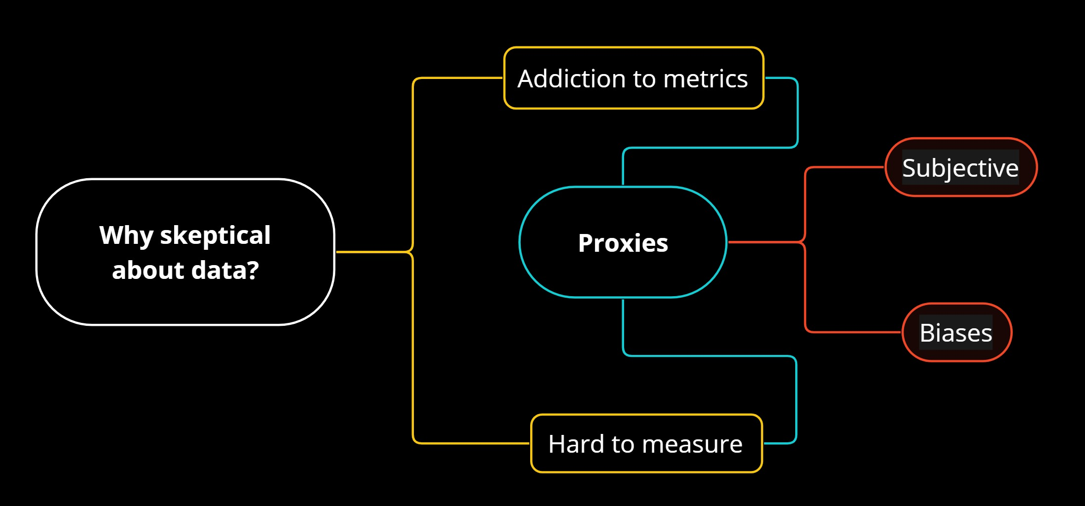
“On Being a Data Skeptic”

Slide 7
“On Being a Data Skeptic”

Slide 8
“On Being a Data Skeptic”
“People Get Addicted to Metrics
“We believe in math because it’s ‘hard’ and because it’s believed to be ‘objective’ and because mathematicians are generally considered trustworthy, being known to deal in carefully considered logical arguments based on assumptions and axioms. We’re taught that to measure something is to understand it. And finally, we’re taught to appear confident and certain in order to appear successful, and to never ask a dumb question.” (4)
Notes:
People Get Addicted to Metrics ->

Slide 9
“On Being a Data Skeptic”

Slide 10
“On Being a Data Skeptic”
“things that are just plain hard to measure: my love for my son, the amount of influence various politicians wield, or the value to a company of having a good (or bad) reputation. How would you measure those things?” (4)

Slide 11
“On Being a Data Skeptic”

Slide 12
“On Being a Data Skeptic”
“When modelers can’t measure something directly, they use proxies—in fact, it’s virtually always true that the model uses proxies.” (5)
“We can’t measure someone’s interest in a website, but we can measure how many pages they went to and how long they spent on each page, for example.” (5)
What are other proxies used in model that you are aware of or have worked with?
Notes:
Use tuition as a proxy variable for income of the students (or the families)

Slide 13
“On Being a Data Skeptic”
Translation process not well-defined!
Notes:
But that translation process is not well-defined: we make lots of choices, sometimes crucial ones. In other words, there’s often more than one way to build a model, even something as simple as a measurement.

Slide 14
“On Being a Data Skeptic”

Slide 15
“On Being a Data Skeptic”
“Ideally advertisers would like to know how well their ads work—do they bring in sales that otherwise they wouldn’t have seen? It’s hard to measure that directly without mind-reading, so they rely on proxies like ‘did that person buy the product after clicking on the ad?’ or, more commonly since the data is so sparse on that question, ‘did that person click on the ad?’ or even ‘did that person see the ad?’.

Slide 16
“On Being a Data Skeptic”
“All of the above might be interesting and useful statistics to track. However, what’s really hard is to know is whether the original question is being answered: are the ads getting people to buy stuff who would not have bought that stuff anyway?” (8-9)

Slide 17
Arguments
So…
Notes:
The biases and subjective perspective the proxies included in our model cannot be avoided. But, we can minimized it!

Slide 18
Arguments
Philosophical Systems

Slide 19
Logical Positivism
“The aim of science—and the aim of everyday thought and problem-solving as well—is to track and anticipate patterns in experience… We can make rational predictions about future experiences by attending to patterns in past experience, but we never get a guarantee. We could always be wrong. There is no alternative route to knowledge besides experience” (Peter Godfrey-Smith, Theory and Reality, p.39)

Slide 20
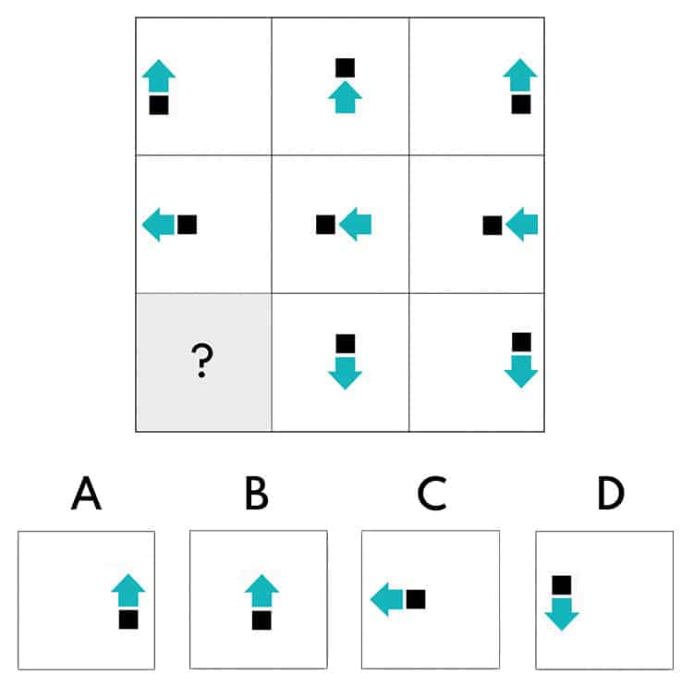
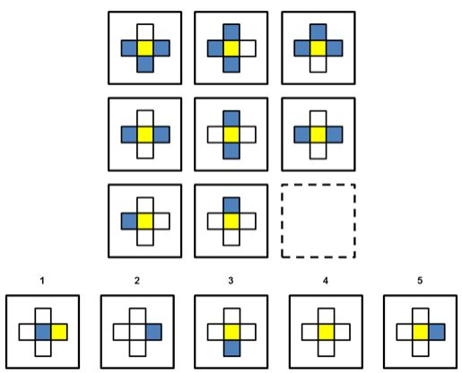
Logical Positivism
Answer: D
Answer: 5

Slide 21
Inductive Skepticism
“What reason do we have for thinking that the future will resemble the past? There is no contradiction in supposing that the future could be totally unlike the past. It is possible that the world could change radically at any point, rendering previous experience useless. How do we know that this will not happen?” (Peter Godfrey-Smith, Theory and Reality, p.54-55)

Slide 22
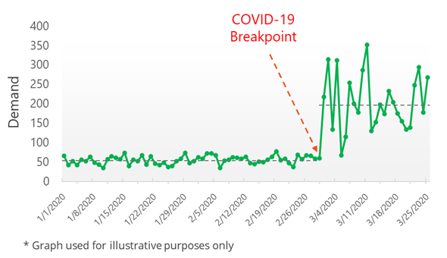
Inductive Skepticism

Slide 23
Values and Sciences
How can we interpret the data?
What factors do we depend on when interpreting the data? Is there any factor at all?
Will everybody interpret the same data the same way?

Slide 24
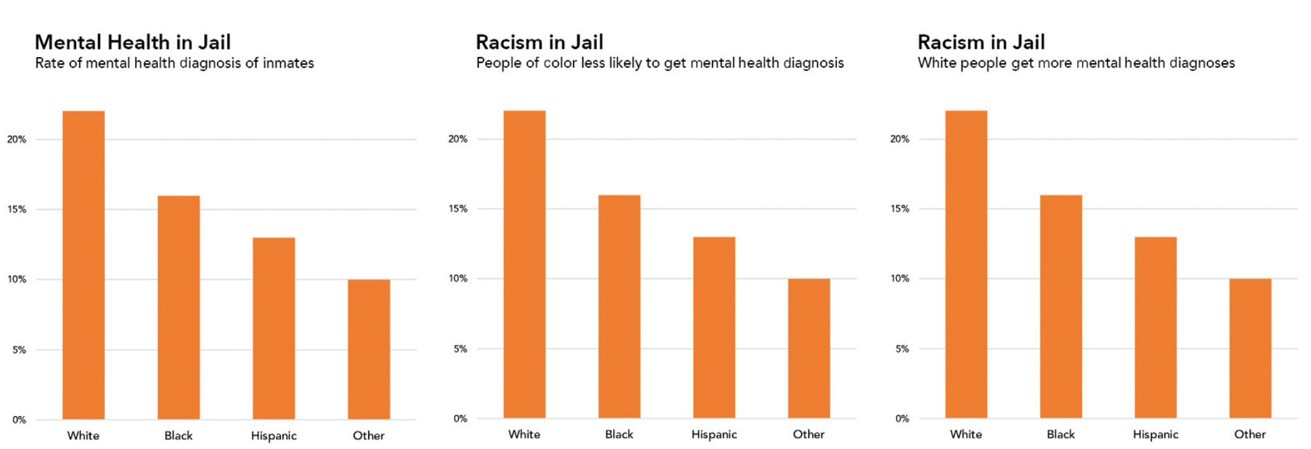
Values and Sciences
Non-epistemic values, such as racial equality or sex/gender equality, affect how we answer a question.

Slide 25
Arguments
Data Bias

Slide 26
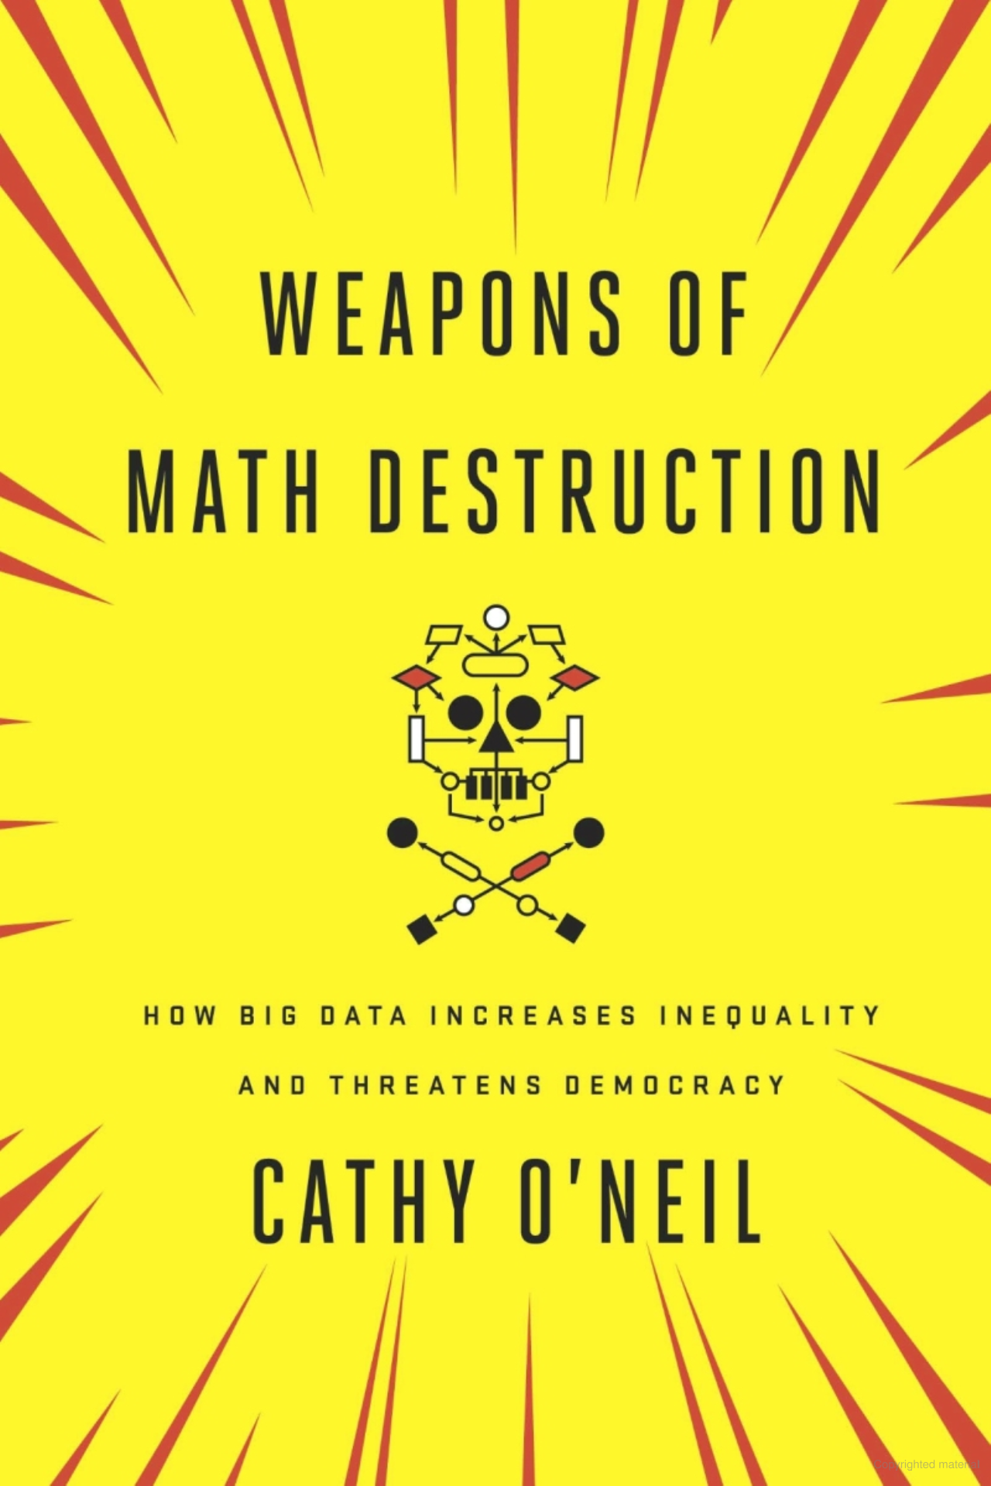
“Weapons of Math Destruction”
The main idea of the book is to challenge the common belief that mathematical models and their outcomes are inherently fair, impartial, and unbiased.

Slide 27
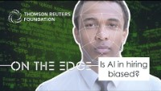

Slide 28
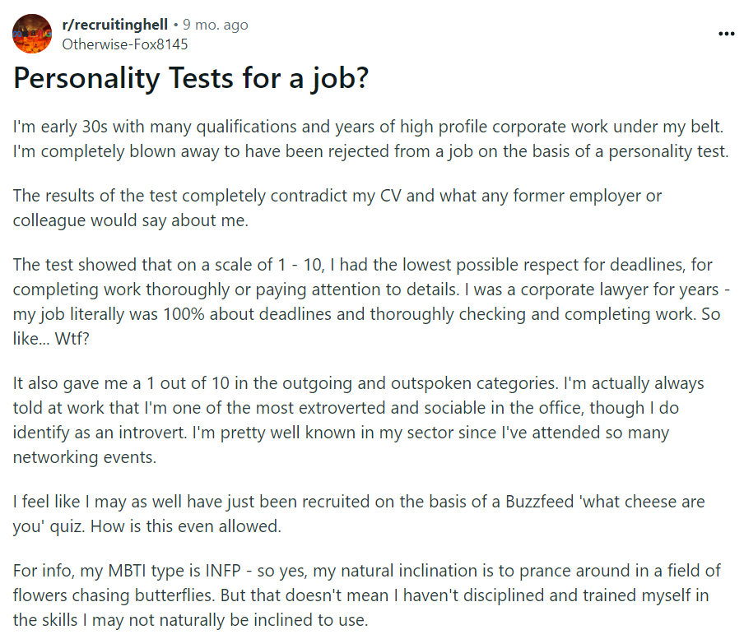

Slide 29
Bias in Hiring/Job Application
1) Have you ever had to complete a personality test for a job application? If so, what kinds of questions were asked?
2) What effect do you think automatic resume screening has had on hiring bias? Is there a way for these models to improve?
3) Virtual Interviews (like HireVue) have been more common than ever regarding the hiring process. Do you think they are biased, inexact, and unfair like the personality test? If you were to choose one during the hiring process, virtual interview or personality test?

